Slide 1
Data-Driven Cloth for Interactive Applications
UE24CS352A MACHINE LEARNING · MINI-PROJECT 2026
Predicting cloth deformation from pose with PCA and a neural network
Tejas Ponnappa · PES1UG24CS498 | Mukesh Sheregar · PES1UG24CS828
Notes:
Suggested presenter: Tejas. Introduce yourselves and the project in one sentence: we reproduced a research paper (Xue and Wu, Stanford CS229, 2021) on predicting how clothing deforms from a character's pose with a neural network. About 8 to 10 minutes plus the live demo and Q&A. Structure: the topic, the original paper, what we did, the problem statement, the dataset, the approach, the implementation, then demo, results and conclusions.

Slide 2
Making clothing move realistically, in real time
TOPIC
Games, VR and online try-on need clothing that reacts to the body instantly. There are three ways to get there.
Physics simulation
Skinning
Data-driven
Very realistic, but slow: about 180 s for one coat in the paper.
Instant, but the cloth just follows the skeleton and looks stiff.
Learn the cloth's behaviour from simulated examples, then predict it in milliseconds.
This project is about the third approach
2 / 12
Notes:
Suggested presenter: Tejas. Explain the topic in plain words. Clothes on a moving character can be produced three ways. A physics simulation solves the cloth's equations step by step: very realistic but slow (the paper reports about 180 seconds for one coat). Skinning attaches the cloth to the skeleton: instant, but the cloth looks stiff. The data-driven idea is to run the slow simulation offline for many poses, then train a model that predicts the simulated cloth from the pose, so it runs in milliseconds. Our project implements and tests this third approach.

Slide 3
Xue & Wu (Stanford CS229, 2021)
ORIGINAL PAPER
What they did
What they found
Simulated 10,000 coat poses with Blender + PhysBAM
Pose (56 numbers) → MLP → PCA coefficients → 6,510 vertex offsets
Compared direct offsets, 256 / 128 / 64 PCs and linear regression
Prediction takes about 0.1 ms on a GPU, versus about 180 s for the simulator
Model | Test cost
Linear regression | 3.83e-4
MLP, direct | 1.59e-4
MLP + PCA 256 | 1.53e-4
MLP + PCA 128 | 1.50e-4
MLP + PCA 64 | 1.57e-4
Lower is better. From Table 1 of the paper.
Best result: 128 PCA components, about 2.6× lower error than linear regression
3 / 12
Notes:
Suggested presenter: Tejas. The paper is a Stanford CS229 project report by Kangrui Xue and Jane Wu. They simulated 10,000 poses of a coat with Blender (skinning) and PhysBAM (cloth simulation). A fully connected network takes the 14 joint quaternions (56 numbers) and predicts PCA coefficients of the coat's vertex offsets; a fixed PCA layer turns them into the 6,510 offsets (2,170 vertices times 3). They compared predicting the offsets directly, 256, 128 and 64 PCA components, and a linear regression baseline. Their best model used 128 components with a test cost of 1.50e-4, about 2.6 times lower than the linear baseline at 3.83e-4. The network predicts in about 0.1 ms on a GPU, versus about 180 s for the procedural simulator on a CPU.

Slide 4
We rebuilt the paper's pipeline end to end
WHAT WE DID
1. Dataset
2. Pipeline
3. Ablation
4. Evaluation
Generated 10,000 poses with cloth offsets, in the paper's format.
Implemented PCA, the MLP and a linear baseline in PyTorch.
Trained direct offsets and 256 / 128 / 64 PCs for 1,000 epochs each.
Measured test error, made plots and built a live demo.
Same pipeline as the paper: pose → MLP → PCA → cloth offsets
4 / 12
Notes:
Suggested presenter: Tejas. Give the four steps in one breath. We built a dataset in the same format as the paper's, implemented PCA, the neural network and the linear baseline in PyTorch, ran the same ablation as the paper (predict the offsets directly, or 256, 128 or 64 PCA components, 1,000 epochs each), and then evaluated on a held-out test set, produced plots and built a live demo. The next slides go through each part in the order of the written report: problem statement, dataset, approach, implementation, then results and conclusions.

Slide 5
Predict the cloth's shape from the character's pose
PROBLEM STATEMENT
Simulating one coat takes about 180 s in the paper, but interactive applications need an answer in milliseconds. We learn a fast model that imitates the simulator.
Input
Output
Goal
The pose: 14 joint rotations as quaternions, 14 × 4 = 56 numbers.
The offset of every cloth vertex between skinned and simulated cloth: 3 numbers per vertex.
Learn the pose-to-offset map with a neural network and compare it with linear regression.
Supervised regression: 56 inputs, one output value per vertex coordinate
5 / 12
Notes:
Suggested presenter: Tejas. This is a supervised regression problem. The input is the pose: 14 joint rotations as quaternions, 56 numbers. The output is, for every cloth vertex, the offset between the cheap skinned cloth and the simulated cloth, 3 numbers per vertex. The goal is to learn this map with a neural network, so a prediction takes milliseconds, and to compare it with a linear regression baseline.

Slide 6
Dataset: generated in the paper's format
DATASET
Paper (Xue & Wu)
Ours (synthetic)
10,000 coat poses, Blender + PhysBAM
2,170 vertices, so 6,510 outputs
9,813 kept after an outlier filter
Split 6,000 / 2,000 / 1,813
Dataset not publicly available
10,000 random poses, 14 joints, 56 inputs
20 × 25 cloth panel, so 1,500 outputs
Fixed nonlinear pose-to-offset function plus noise
About 1% faulty samples, removed by an outlier filter
Same split: 6,000 / 2,000 / rest
Built to mirror the paper's setup, so the whole pipeline can be trained and tested end to end.
PCA is fitted on training data only
6 / 12
Notes:
Suggested presenter: Tejas. The paper's coat dataset (Blender skinning plus PhysBAM simulation) is not publicly available, so we generate a dataset with the same shape. Random joint rotations go through a fixed nonlinear function to give per-vertex offsets of a 20 by 25 panel, plus a little noise. About 1% of samples are deliberately made faulty to mimic bad simulations, and an outlier filter (median plus 5 robust standard deviations of the largest vertex displacement) removes them, like the paper's distance threshold. Split: 6,000 train, 2,000 validation and the rest for test. PCA is fitted on training data only to avoid leakage. If asked why synthetic: the original data is not public, and public cloth datasets we know of cover other garments and use a different body model, so we kept the paper's setup. Be clear that results are on this generated data.

Slide 7

Pose goes in, cloth offsets come out
APPROACH
Pose
MLP
PCA coeffs
PCA layer
Offsets
56 joint quaternions
128, 256 hidden units, ReLU
k = 64, 128 or 256
fixed, not trained
1,500 values per pose
Teal = trained, navy = fixed. k is the number of principal components kept.
PCA
Training
Baseline
Fitted on training offsets only; keeps the top-k directions.
MSE on offsets, Adam, lr 1e-4, batch 32, 1,000 epochs.
Linear regression, no hidden layer; also direct offsets without PCA.
Loss is measured on the reconstructed vertex offsets
7 / 12
Notes:
Suggested presenter: Mukesh (this is the part his modules pca.py and model.py implement). Walk left to right. The MLP has two hidden ReLU layers (128 and 256 units) and outputs k PCA coefficients. The PCA layer is a fixed linear layer built from the top-k principal components of the training offsets plus the mean, so the loss is the mean squared error on the reconstructed vertex offsets. PCA reduces the output from 1,500 numbers to k. Training uses Adam, learning rate 1e-4, batch size 32, 1,000 epochs as in the paper; we keep the checkpoint with the best validation loss. The baseline is linear regression, which is a network with no hidden layers; we solve it in closed form by least squares. The ablation compares predicting the offsets directly with k = 256, 128 and 64. Likely question: why PCA? Answer: cloth offsets are strongly correlated across vertices, so a few components describe them; it makes the output layer and the model much smaller and acts as a regulariser.

Slide 8
Six small files, each with one job
IMPLEMENTATION
File | What it does
src/data.py | Generates the data, filters outliers, splits train / val / test
src/pca.py | PCA by SVD on the training offsets, top-k components
src/model.py | MLP with a fixed PCA layer; closed-form linear baseline
src/train.py | Training loop; keeps the best-validation checkpoint
src/evaluate.py | Test metrics, timing and all the plots
demo.py | Live viewer: ground truth vs predicted cloth
PyTorch, NumPy, Matplotlib. Private GitHub repo with a README; one script reproduces every result.
Run: python -m src.train --name pca128 --mode pca --k 128
8 / 12
Notes:
Both presenters. Suggested split: Tejas covers data.py, train.py and demo.py; Mukesh covers pca.py, model.py and evaluate.py (the three modules he added to the repository). Mention that the repository is private and shared with the faculty, that the README has setup and run commands, and that run_all.bat regenerates the data, trains all models and produces the plots and results table. Mukesh's files in one sentence each: pca.py fits PCA with an SVD on the training offsets and gives the top-k components; model.py defines the MLP whose last step is a fixed linear layer built from those components, plus the closed-form linear baseline; evaluate.py loads each trained model, computes test error, per-vertex error and timing, and draws the plots.

Slide 9
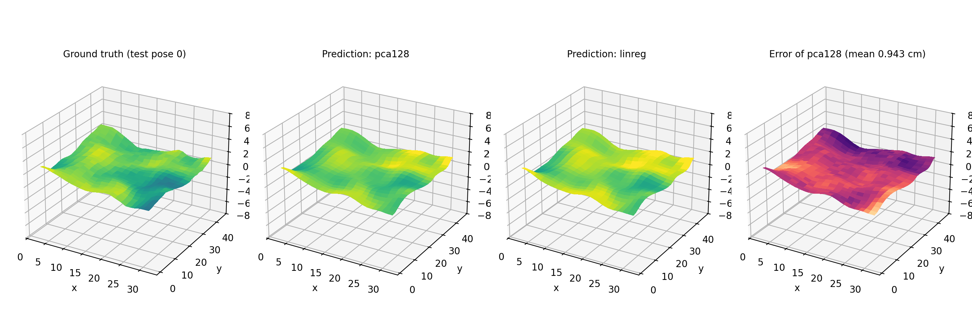
Ground truth vs prediction on a test pose
LIVE DEMO
Left to right: ground truth, pca128, linear regression, error map of pca128. Arrow keys step through test poses.
python demo.py --model pca128 --compare linreg
9 / 12
Notes:
Suggested presenter: Tejas. Before the review starts, run python demo.py --model pca128 --compare linreg and keep the window open. Left to right: the ground-truth cloth, the pca128 prediction, the linear-regression prediction, and the error map of pca128. Use the left and right arrow keys to step through test poses and show three or four of them. The numbers on the next slide show the difference between the models. If the window fails to open, this screenshot is the fallback.

Slide 10
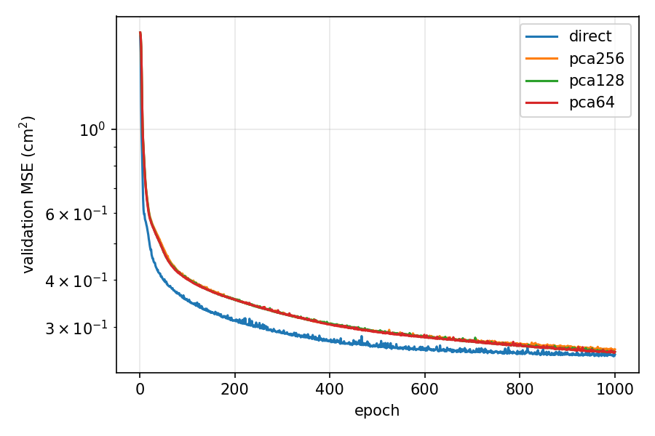
The neural networks cut the error by about 35%
RESULTS
Model | Params | Test MSE | Vertex err.
Predict mean | 0 | 1.831 | –
Linear regression | 85,500 | 0.392 | 0.991
MLP direct | 425,820 | 0.251 | 0.789
MLP + PCA 256 | 106,112 | 0.253 | 0.794
MLP + PCA 128 | 73,216 | 0.254 | 0.795
MLP + PCA 64 | 56,768 | 0.250 | 0.790
Validation MSE over 1,000 epochs
All four networks reach a similar error, and the PCA versions are up to 7.5× smaller.
Test set (seed 0). MSE in cm², vertex error = mean distance per vertex in cm.
10 / 12
Notes:
Suggested presenter: Mukesh (evaluate.py produces these numbers and plots). Test set, seed 0. Predicting the training mean gives an MSE of 1.83; linear regression 0.392; all four neural networks between 0.250 and 0.254, which is about 35 percent lower than linear regression. The four networks are within about 1.5 percent of each other, so we describe them as performing alike rather than ranking them. In the paper, 128 components was best; on our generated data every choice of k performs alike. Training took 459 to 537 seconds per model for 1,000 epochs. Prediction takes about 0.1 to 0.2 ms per pose on a CPU. Likely question: what is vertex error? Answer: the mean Euclidean distance, in cm, between predicted and true position of each cloth vertex.

Slide 11
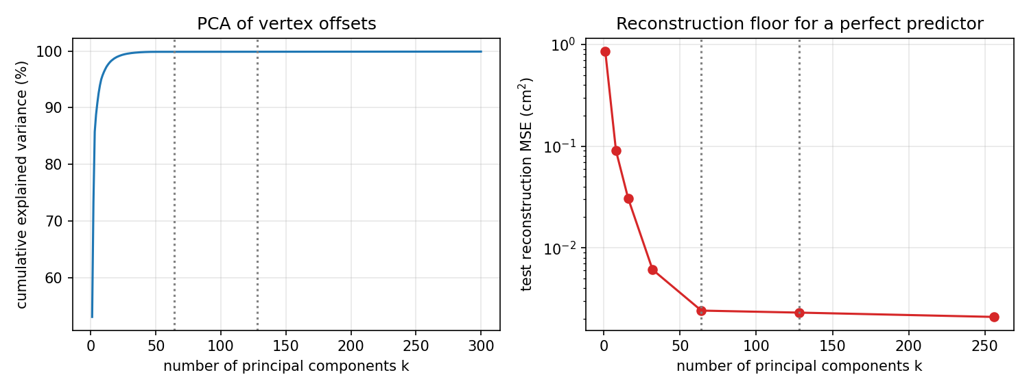
PCA keeps the accuracy and shrinks the model 7.5×
ABLATION
over 99.8%
of the offset variance in 64 components
7.5× fewer
parameters: 56.8k vs 425.8k
With 64 components the reconstruction error is only about 0.002, compared with a model error of about 0.25.
Explained variance and reconstruction error on the test set
11 / 12
Notes:
Suggested presenter: Mukesh (pca.py computes this). Left plot: cumulative explained variance of the offsets against the number of components. Right plot: the reconstruction error that even a perfect predictor would still have, on the test set. By 64 components that floor is about 0.002 in MSE, compared with a model error of about 0.25, so PCA is not what limits accuracy. 64 components give a network with 56.8 thousand trainable parameters versus 425.8 thousand for direct prediction, 7.5 times fewer, at essentially the same accuracy (0.250 versus 0.251). The 99.8 percent figure is approximate (about 99.87 percent, from the reconstruction error relative to the total variance). Likely question: why not use fewer than 64? Answer: the curve is flat beyond about 50 to 64 components, so fewer would start to lose detail.

Slide 12
Learned cloth is fast, accurate and compact
CONCLUSIONS
Our findings
Compared with the paper
Neural networks cut test MSE by about 35% vs linear regression (0.392 to 0.250–0.254)
PCA gives a 4–7.5× smaller network at essentially the same accuracy
About 0.1–0.2 ms per pose on a CPU, far below a 16 ms frame
Same trends: the MLP beats linear regression and PCA shrinks the model
The paper found k = 128 best; on our generated data every k performs alike
Next: real simulated cloth and several random seeds
Code: private GitHub repo with README · Report: 2-page PDF · Questions?
Tejas Ponnappa (PES1UG24CS498) · Mukesh Sheregar (PES1UG24CS828)
12 / 12
Notes:
Suggested presenter: Tejas. Summarise the three findings, then how they compare with the paper. We reproduce the main trends: the neural network clearly beats linear regression and PCA gives a much smaller model at the same accuracy. The paper's preference for 128 components does not show up on our generated data, where all choices of k perform alike; the likely reason is that our generated offsets are smooth and low-rank, and we would test this with real simulated cloth. Future work: real simulated cloth, for example from a mass-spring simulation; several random seeds; and temporal information, since the paper notes its formulation has no temporal coherence. Then invite questions.

